Slide 1
CAN LLMS DECIDE? GENERALIZATION VS. CALIBRATION IN EMAIL PREDICTION

Slide 2
AGENDA
The Crux – LLMs Fail to Generalize
Why – Intuition & Noise
Implication – Rethinking Agents

Slide 3
The Future Of AI Email Agents: Can LLMs Really Deliver?
Microsoft is the land of knowledge workers — Outlook and Teams connect billions.
If AI could reliably predict replies, we could transform global productivity.
Over 376B emails sent per day — even a 5% improvement in handling saves millions of hours
[1] Daily number of e-mails worldwide 2017–2026. Statista. Retrieved September 2, 2025, from https://www.statista.com/statistics/456500/daily-number-of-e-mails-worldwide/
Notes:
Microsoft is the land of email — Outlook and Teams are at the center of how the world communicates.
Imagine if an AI agent could reliably tell you which emails you’ll get a reply to, and which will be ignored.
The productivity implications are enormous.
Prior research suggested this was possible with traditional ML. The natural question is — can LLMs finally make this real?

Slide 4
Feature Engineering Works… Up to a Point
  Prior research (e.g., ML with hand-crafted features) showed reply likelihood can be predicted (?)
Method | AUC
Random | .50
LR | .70
AdaBoost | .72
  Models captured metadata & structural cues — sender, time, thread history.
  Performance was decent but brittle, requiring heavy feature engineering
… can LLMs do better, by learning directly from the text?
Can they discover something new?
[2] Yang, L., Dumais, S. T., Bennett, P. N., & Awadallah, A. H. (2017). Characterizing and predicting enterprise email reply behavior. https://doi.org/10.1145/3077136.3080782
Notes:
This problem isn’t new. In fact, with enough hand-crafted features, classical ML like Ada Boost can do a pretty good job at predicting whether an email will get a reply.
It works — but only because we feed in lots of engineered signals like thread history or sender reputation.
These models are brittle and expensive to maintain.
That’s why it’s so natural to ask: can LLMs do better, by learning directly from the text?

Slide 5
CAN LLMs Understand what ML can’t?
LLMs are powerful pattern matchers — they calibrate well to known data.
But: Can they generalize to the messy, ambiguous, high-noise world of email?
This is the critical test for building autonomous AI agents
Notes:
This is where the research challenge really lies. LLMs are fantastic at calibrating — they can pick up on patterns and surface-level cues in existing data. But the true test is generalization: can they handle new, messy, ambiguous cases the way a real agent would need to? That’s the difference between a toy demo and a system that could power Outlook or Teams at scale

Slide 6
Can LLMs Outperform Classical Models in Reply Prediction?
Our baseline: XGBoost — also tree ensemble model, ideal for tabular data and highly interpretable through feature-level gain tracking.
We gave LLMs every chance to excel:
Text-only (semantic cues)
Post-hoc calibration: isotonic regression + verbal strategies
Features + content (structured + text)
Few-shot dyad retrieval (sender–recipient in-context)
[3] Giovannotti, P., & Gammerman, A. (2024). Calibrated large language models for binary question answering. In S. Vantini, M. Fontana, A. Solari, H. Boström, & L. Carlsson (Eds.), Proceedings of Machine Learning Research (Vol. 230, pp. 1–18). PMLR. https://arxiv.org/abs/2407.01122
[4] Tian, K., Mitchell, E., Zhou, A., Sharma, A., Rafailov, R., Yao, H., Finn, C., & Manning, C. D. (2023). Just ask for calibration: Strategies for eliciting calibrated confidence scores from language models fine-tuned with human feedback. arXiv preprint arXiv:2305.14975. https://doi.org/10.48550/arXiv.2305.14975
Notes:
We raised the bar by using XGBoost as a stronger, interpretable baseline.
Then we gave LLMs every possible advantage — testing pure text input, mixing structured features with content, retrieving sender–recipient examples, and applying state-of-the-art calibration methods like isotonic regression.
If LLMs were going to shine, this was the fairest stage to prove it

Slide 7
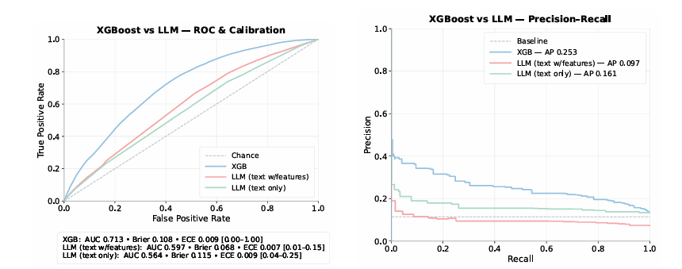
Generalization vs. calibration
Calibration improves reliability (Brier/ECE) but not separability
LLMs perform near chance (~0.56–0.59 AUC), even after calibration

Slide 8
Why – Intuition & Noise
NN
NN
LLM is learning what a human would
Maybe the task is too noisy?
So llm can be good at knowing an email with question should be answered but cant generalize to new realistic data

Slide 9
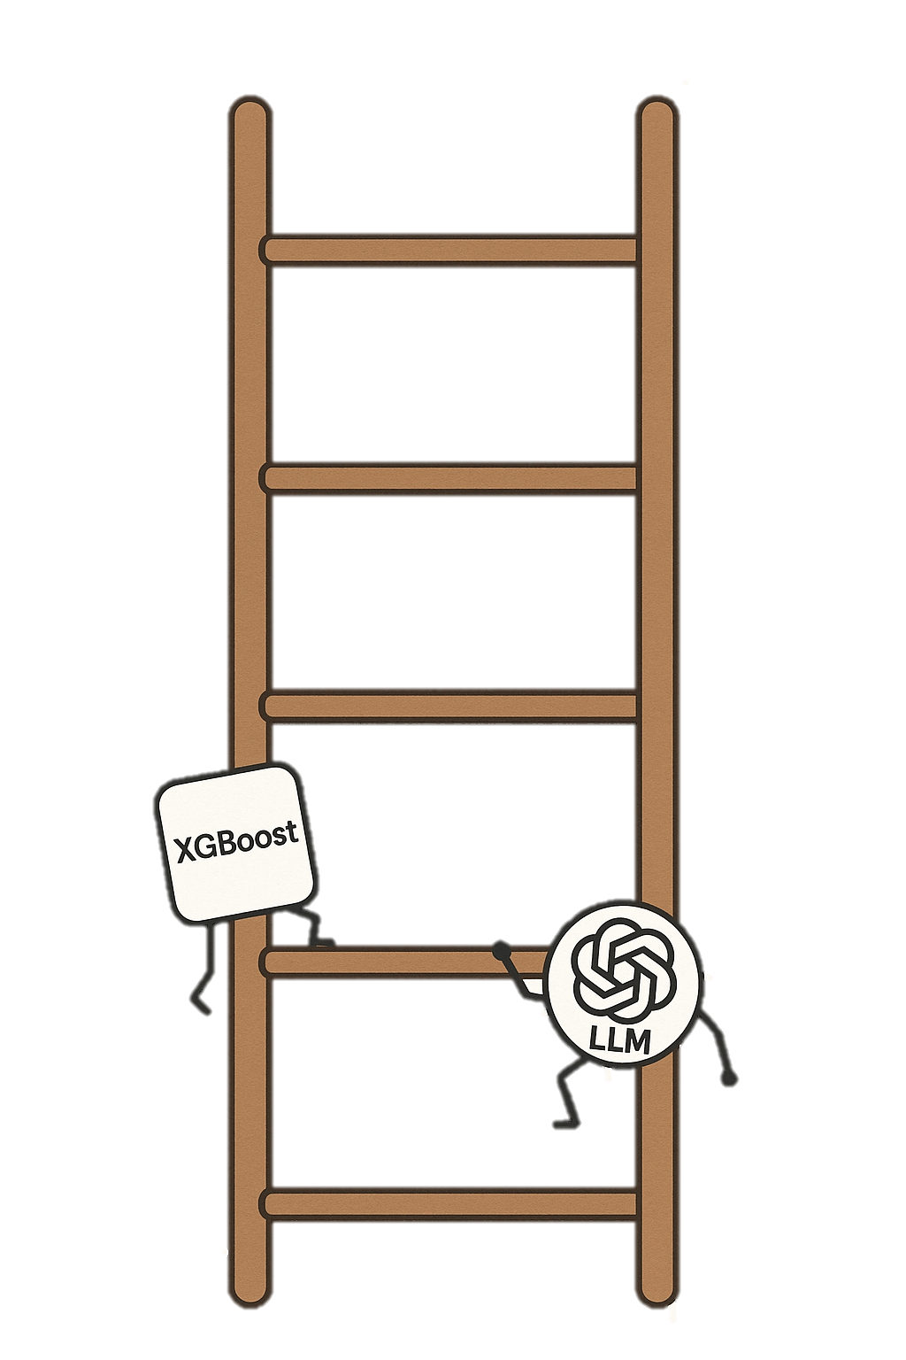
From Shortcut Fit to Real-World Generalization
We stress-test models by removing shortcuts and adding real-world uncertainty step by step.
Hold the task constant, vary the uncertainty. Same reply-prediction task; we only change what information is usable.
Remove shortcut signals first. Strip features that make the problem “too easy” (e.g., reply history proxies), then escalate realism.
Validate each rung. For every cohort we run leakage checks, time splits, and human sanity checks.

Slide 10
Prove shortcuts exist and quantify how much they help; this calibrates expectations.
Notes:
This is where the research challenge really lies. LLMs are fantastic at calibrating — they can pick up on patterns and surface-level cues in existing data. But the true test is generalization: can they handle new, messy, ambiguous cases the way a real agent would need to? That’s the difference between a toy demo and a system that could power Outlook or Teams at scale

Slide 11
Cohort 1:Baseline-Comparable
Purpose. Evaluate calibration in scenarios where the model should perform comparable to the baseline
— i.e., when historical behavior strongly predicts the outcome.
Design Rationale. Prior-dominated cases, aligned with baseline filtering logic:
One class dominates.
Recipient reply history guides predictions.
Structural features (e.g., sender elicitation rate) help distinguish minority class.
Notes:
(Low-reply users)
Why this slice:
We wanted a cohort where reply rates are very low, so a trivial baseline (“almost always no”) is already strong.
This tests whether models can still find any signal in cases where the dominant outcome is “no reply.”
Why it’s easier for XGBoost:
A single feature — the recipient’s historical reply rate — explains most of the variance.
The model doesn’t need to read text carefully: the prior behavior is already highly predictive.
Expected performance:
Accuracy is high because the “no reply” class dominates.
We expected XGBoost to perform well here (70%+), mostly by exploiting this strong prior.
(High-reply users)
Why this slice:
The mirror image of low-reply users: recipients who reply to almost everything.
This gives us another clear, prior-dominated case that makes the task simpler.
Why it’s easier for XGBoost:
Again, the recipient’s reply rate dominates.
Predicting “yes” most of the time is correct, and structured features provide enough lift to improve further.
Expected performance:
Because the “reply” class dominates, accuracy is high.
We expected XGBoost to capture this easily, with performance in the same range as low-reply users (~70%).

Slide 12
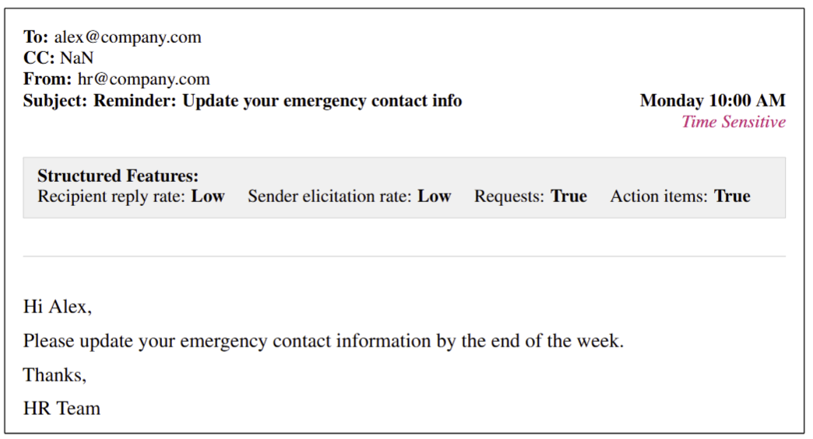
Low-Reply Recipients
Why. Rare replies make “no” a strong default
Hypothesis. Historical reply rate alone explains most variance
⚠️
High-Reply Recipients
Why. Frequent replies simplify prediction.
Hypothesis. Predicting yes is usually correct; structures features help refine label distinctions
As expected XGBoost AUC ~ 0.70

Slide 13
COHORT 2: Intermediate difficulty
Test cases where historical priors alone are not enough.
Force models to rely on a mix of textual signals, structured features, and weaker history.
Demonstrate whether performance generalizes beyond easy baselines into more realistic, mid-difficulty slices.
Unlike baseline slices, where performance is mostly about picking up priors, here the model must actually learn patterns that combine history, text, and context.

Slide 14
High-engagement exchanges: high-reply senders & recipients
Both the sender and recipient have strong reply history. Almost everything looks like it should get a reply.
What it tests: if model can detect the rare exceptions (the “no reply” cases hidden inside a mostly positive class).
Expected difficulty: Harder than baselines because priors overwhelm the distribution; requires finer discrimination.
New Senders: cold-start sender
Few-shot interactions: rare sender-recipient pairs
Sender has never appeared in training. Recipient priors exist, but sender behavior is unknown.
What it tests: if models can generalize without sender history
Expected difficulty: some prior signal remains (recipient), but one major dimension is missing.
Sender–recipient pairs appear once or twice, and senders have sent very few total emails
What it tests: The ability to make predictions with very sparse historical data.
Expected difficulty: priors exist but are too weak to dominate; content and generalization matter more.
XGBoost performance dips compared to baselines (~60–65%), showing the task is non-trivial but still feaasible.
Notes:
Cohorts
(High-engagement exchanges)
(high-reply senders & recipients)
Why this slice:
Both the sender and recipient have strong reply history. Almost everything looks like it should get a reply.
What it tests:
Whether the model can detect the rare exceptions (the “no reply” cases hidden inside a mostly positive class).
Expected difficulty:
Harder than baselines because priors overwhelm the distribution; requires finer discrimination.
(New senders)
(cold-start sender problem)
Why this slice:
The sender has never appeared in training. Recipient priors exist, but sender behavior is unknown.
What it tests:
Whether models can generalize without sender history, by relying on content and recipient context.
Expected difficulty:
Intermediate: some prior signal remains (recipient), but one major dimension is missing.
(Few-shot interactions)
(rare sender–recipient pairs)
Why this slice:
Sender–recipient pairs appear once or twice, and senders have sent very few total emails.
What it tests:
The ability to make predictions with very sparse historical data — closer to realistic enterprise cold-start cases.
Expected difficulty:
Between easy and hard: priors exist but are too weak to dominate; content and generalization matter more.
What These Cohorts Prove
Unlike baseline slices, where performance is mostly about picking up priors, here the model must actually learn patterns that combine history, text, and context.
XGBoost performance dips compared to baselines (~60–65%), showing the task is non-trivial but still feasible.
These cohorts validate that the evaluation ladder is progressively harder: baseline → intermediate → hard.

Slide 15
Hard Cohorts — Stress Testing Generalization
Push models into situations where priors alone mislead or provide no guidance.
Force reliance on subtle textual/contextual cues or anomaly detection.
Show where both XGBoost and LLMs struggle most — highlighting the limits of reply prediction.
Notes:
Push models into situations where priors alone mislead or provide no guidance.
Force reliance on subtle textual/contextual cues or anomaly detection.
Show where both XGBoost and LLMs struggle most — highlighting the limits of reply prediction.

Slide 16

Feature drift
Your ability to communicate effectively will leave a lasting impact on your audience
Effectively communicating involves not only delivering a message but also resonating with the experiences, values, and emotions of those listening

Slide 17
Hardness certificate
METRIC | MEASUREMENT | TARGET | ACTUAL
Audience attendance | # of attendees | 150 | 120
Engagement duration | Minutes | 60 | 75
Q&A interaction | # of questions | 10 | 15
Positive feedback | Percentage (%) | 90 | 95
Rate of information retention | Percentage (%) | 80 | 85
Learn to infuse energy into your delivery to leave a lasting impression
One of the goals of effective communication is to motivate your audience

Slide 18
THANK YOU
Brita Tamm
502-555-0152
brita@firstupconsultants.com
www.firstupconsultants.com

